Slide 1

Bangladesh Army University of Science & Technology (BAUST), Saidpur
Department : Computer Science & Engineering
Course Code : CSE 2200
Course Title : Software Development Project II
Submitted By :
Submitted To :
Student Name : M. M. Shahriar Shakil
ID : 180201075
Level : 2 Term : II
Section :B
Date of Submission : 29/11/2020
Teacher Name :
MD. Toukir Ahmed
Designation : Lecturer
Project Name: LUDO Game Page: 01

Slide 2
Proposed Project
LUDO GAME USING JAVA
Project Name: LUDO Game Page: 02

Slide 3
Objective
Ludo is a popular game in android and windows system. In this game 4 player can play this game at a time. Every player has his own colour pawn and a dice. When he get six in dice his game will start. Finally who finish his game first he will be winner. This game want a low system requirement. That’s why everybody can play this game with his friend easily.
Project Name: LUDO Game Page: 03

Slide 4
Use apparatus for the project
Windows 10 operating system
NetBeans IDE code editor
Java Language
I also get some help from:
www.youtube.com
www.code-projects.org
www.codesource.com
Project Name: LUDO Game Page: 04

Slide 5
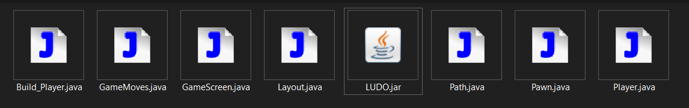
Important parts of program
I make 7 part of the program:
Project Name: LUDO Game Page: 05

Slide 6
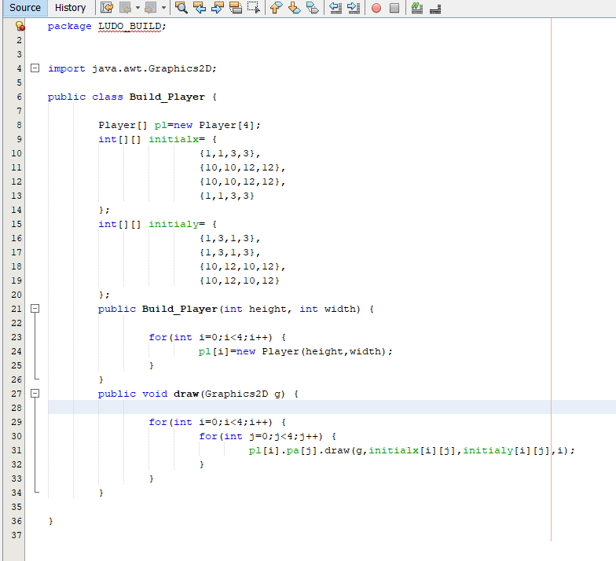
Important parts of program
Build_player.java
This part make 4 player and their board size and their position
Project Name: LUDO Game Page: 06

Slide 7
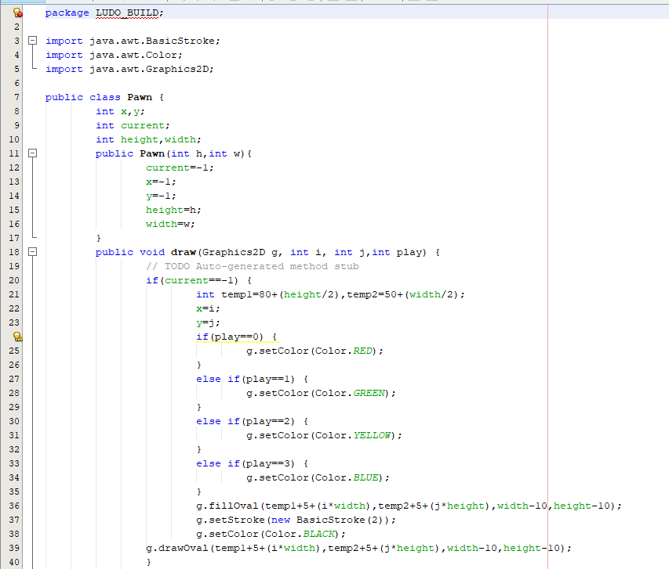
Important parts of program
Pawn.java
By this I make pawn for every player with different colour
Project Name: LUDO Game Page: 07

Slide 8
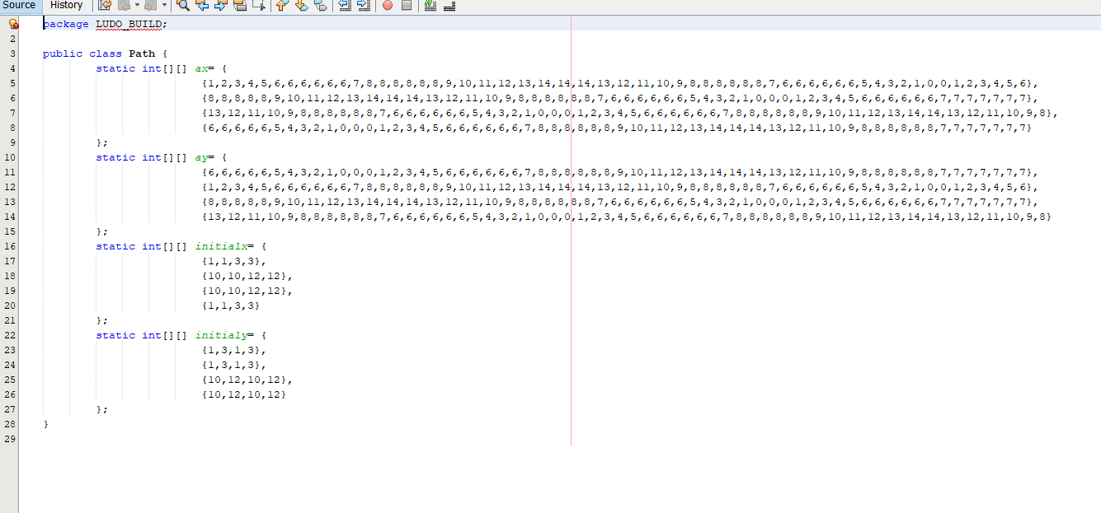
Important parts of program
Path.java
This part make all path of pawn where all pawn go to the final point
Project Name: LUDO Game Page: 08

Slide 9
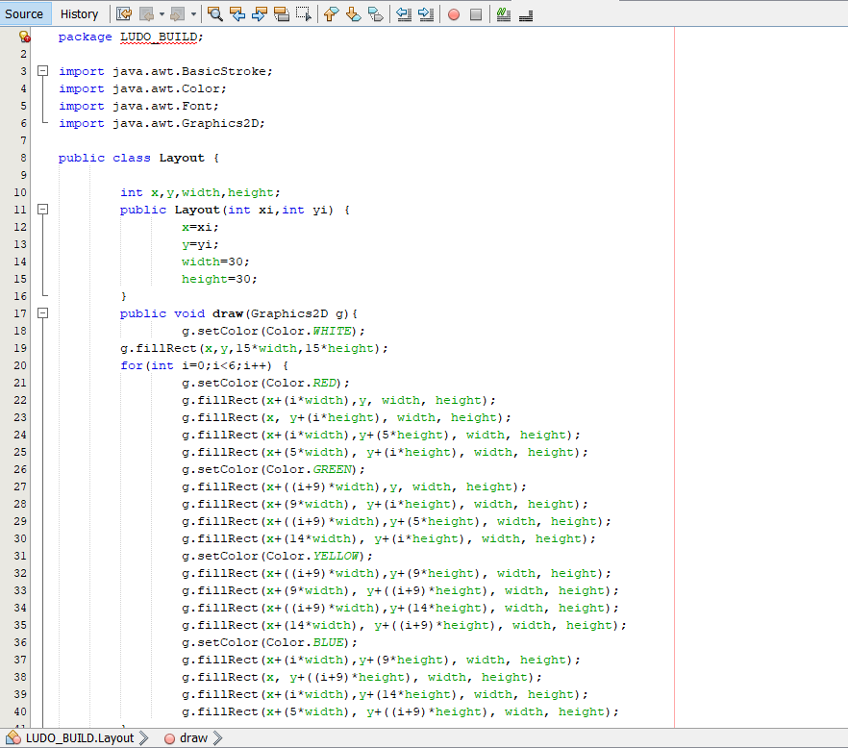
Important parts of program
Layout.java
This is the main part of the program. All colour, box size, graphics are made in this code.
Project Name: LUDO Game Page: 09

Slide 10
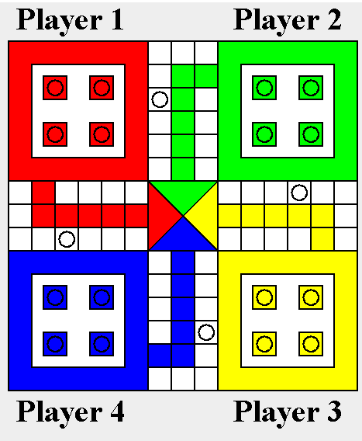
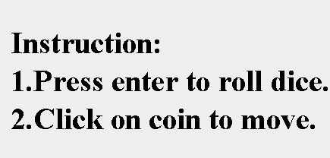
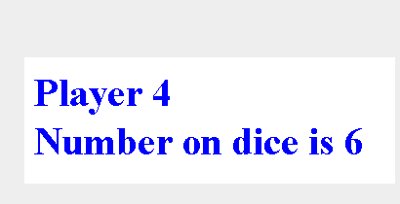
Some picture of my project
Three part of the game interface
Main Board
Instruction part
Result Display
Project Name: LUDO Game Page: 10

Slide 11
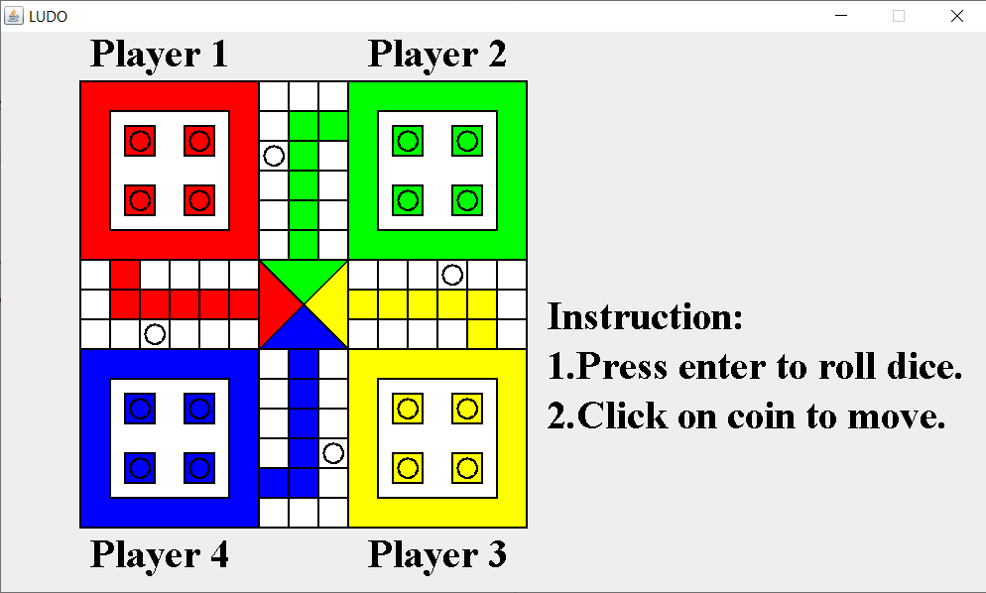
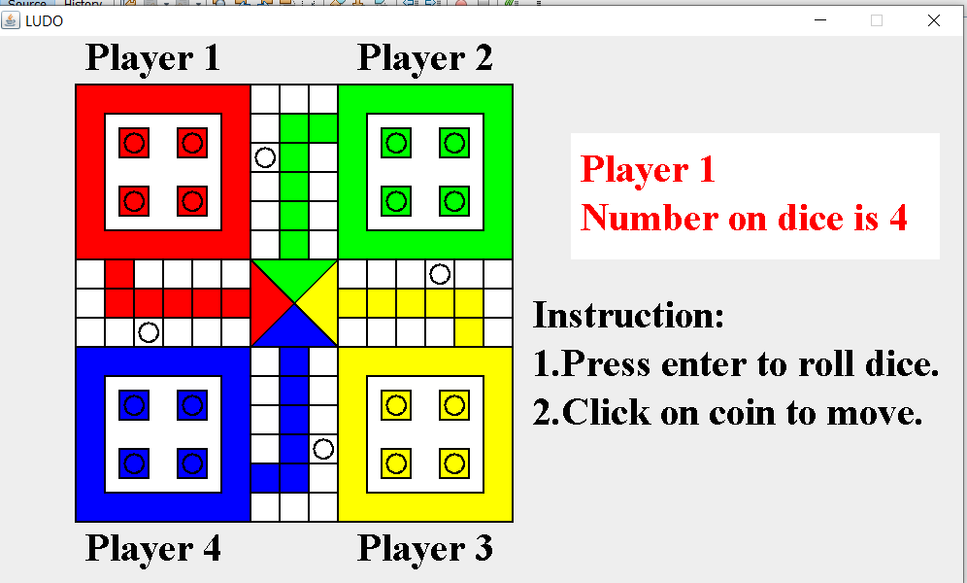
Some picture of my project
1. Main interface of game
2. After first spin of dice
Project Name: LUDO Game Page: 11

Slide 12
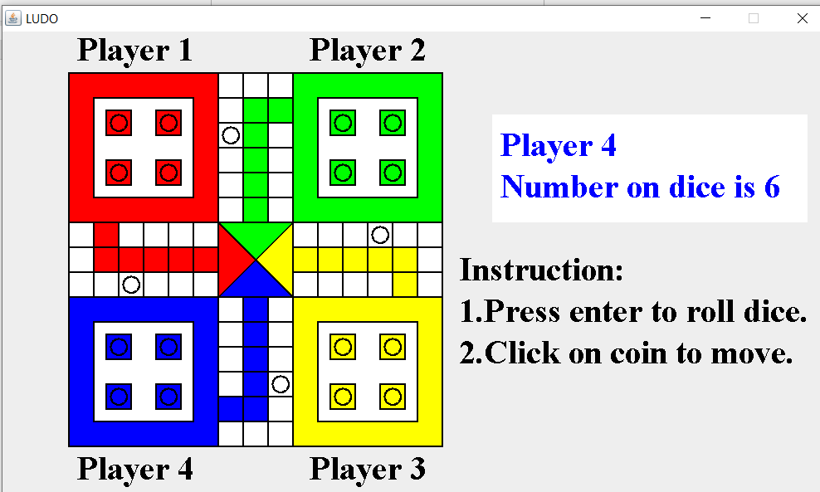
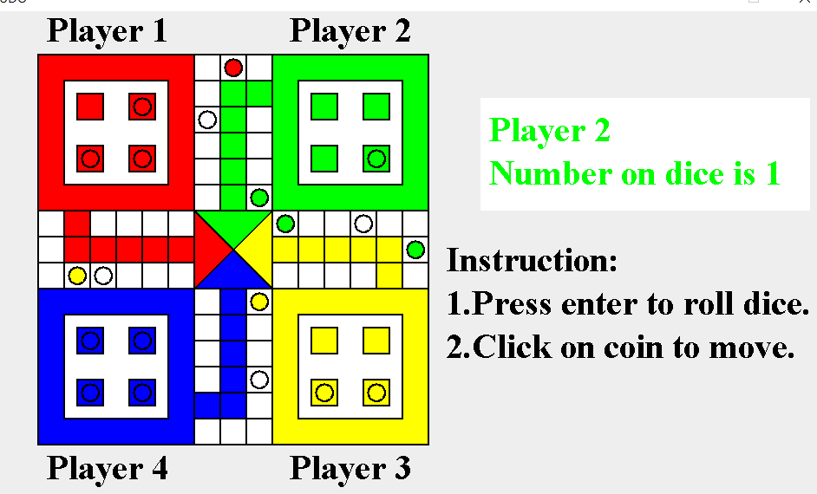
Some picture of my project
3. When first player get 6
4. Pawn are moving
Project Name: LUDO Game Page: 12

Slide 13
Future Plan
In future I will improve graphics in game. Now only four person can play this game but I will add 2 person or 3 person option in game . As a result 2 or 3 person can play this game at a time. And I will make online version of this game.
Project Name: LUDO Game Page: 13

Slide 14
THANK YOU
Project Name: LUDO Game Page: 14

